Slide 1
Lecture 4.3 - Sparse Coding

Slide 2

The GPU Teaching Kit is licensed by NVIDIA and New York University under the
Creative Commons Attribution-NonCommercial 4.0 International License.
Deck credit: Joan Bruna
Yann LeCun
Julien Mairal
Koray Kavukcuoglu

Slide 3



Sparse modeling
Goal: Discover and exploit patterns in high-dimensional data:

Slide 4
Sparse modeling
Goal: Discover and exploit patterns in high-dimensional data:

Slide 5
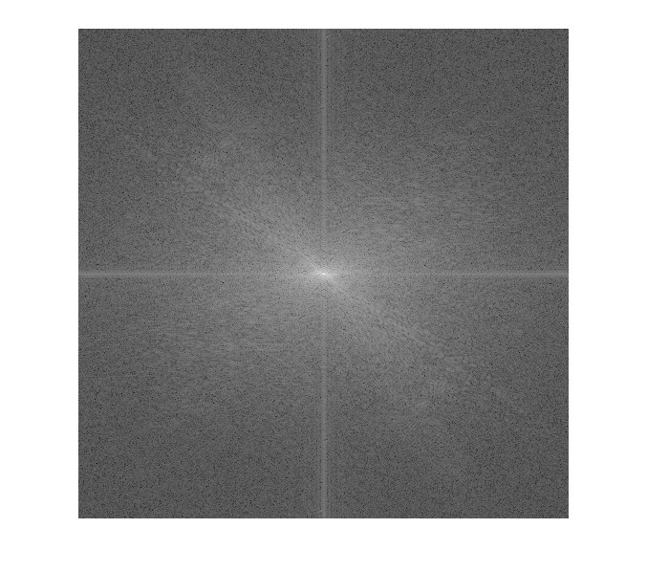

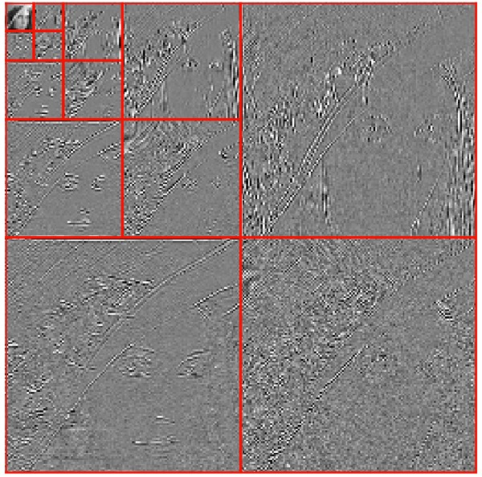
Sparsity in signal processing
What is a “good” basis?
Pixels (Dirac basis)
Fourier
Wavelets

Slide 6
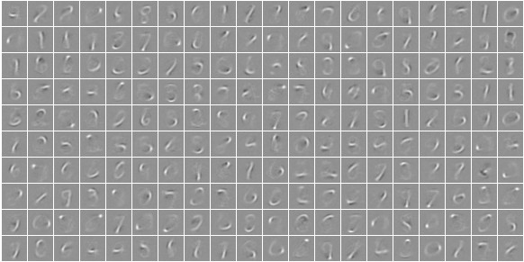
Sparsity in signal processing
More zeros with a redundant dictionary:
Even more zeros with adapted dictionaries:
handwritten digit dictionary

Slide 7
Sparse modeling
Inverse problems in image processing
Denoising, inpainting, super-resolution,…
Unsupervised learning
Video-surveillance, source separation,..
Supervised learning
Object recognition

Slide 8
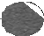
K-Means
_{Y} i

Slide 9
K-Means
_{Y} i
_{M}k

Slide 10

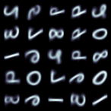
K-Means on MNIST
_{Y} i
_{M}k
(K = 25)

Slide 11
K-Means algorithm
Minimize wrt M:
Lloyd Algorithm: Fix M and update assignment:
For each
Fix assignment and update M :
For each

Slide 12
How to use K-Means?
For a new sample Y, find k such that
Representation (1 of K)
For k = 1..K
zk = (M^{k} - Y)^{T} (M^{k} - Y)
End
k = index of min(z)

Slide 13
Sparse coding
Represent an input vector using an overcomplete dictionary
Each Y is represented using a linear combination of columns of D
How do we calculate z for a given Y?
How do we learn D?

Slide 14
Sparse coding - L0
Find the sparsest solution that satisfies a given reconstruction error
Find the best k-sparse representation that minimizes reconstruction error
L0 minimization requires search
not tractable

Slide 15
Sparse coding - L0
Matching Pursuit Algorithms offer greedy solution [Mallat and Zhang ’93]
Greedily pick the dictionary element that reduces residual most
Very fast, but unstable

Slide 16
Matching pursuit example
Y
D

Slide 17
Matching pursuit example
k = 1
Y
Y - R
R
1600 1400
1200
1000
800
600
400
200
Z
0
0
100
200 300
400
500 600
700 800
900 1000

Slide 18
Matching pursuit example
k = 11
Y
Y - R
R
800
Z
600
400
200
0
−200
−400
0
100
200
300
400
500
600
700
800
900
1000

Slide 19
Matching pursuit example
k = 21
Y
Y - R
R
500
400
Z
300
200
100
0
−100
−200
−300
−400
0
100
200
300
400
500
600
700
800
900
1000

Slide 20
Matching pursuit example
k = 31
Y
R
Y - R
500
400
Z
300
200
100
0
−100
−200
−300
−400
0
100
200
300
400
500
600
700
800
900
1000

Slide 21
Sparse coding - L1
Relax L0 into closest convex penalty
Equality of minimum for L0 and L1 is proven under certain conditions [Donoho and Elad ’03]
Convex in z and D separately, not both
Fast algorithms exist for solving wrt z

Slide 22
Sparse coding - L1
Proximal Splitting Methods (gradient descent):
1st order methods
Formulation for general functions of the form
F convex, smooth, with Lipschitz continuous gradient L_{F} .
G convex, continuous, and possibly non smooth.
Quadratic Approximation of F(z)+G(z) at z’:

Slide 23
Sparse coding - L1
Minimize Q(z,z’) with respect to z:
Unique minimizer
PROXIMAL OPERATOR of F+G:
Iterative Shrinkage Thresholding Algorithm (ISTA):

Slide 24
Sparse coding - L1
Loop until some convergence criterion is satisfied
How do we get L?

Slide 25
Sparse coding - L1
L is the step size for gradient step
It is the smallest Lipschitz constant of the smooth function F(z) and is equal to largest eigenvalue of DTD
In practice, one does a line search

Slide 26
Sparse coding - L1
Convergence Rate of ISTA:
Can we find a faster first-order method?

Slide 27
FISTA [Nesterov’83, Beck and Teboulle’09]
Use Momentum in a clever way:
First Order, Optimal convergence for 1st order method:

Slide 28
Sparse coding - Learning
How about D?
We want to learn it Adapt to data
Use online learning for D
Per sample energy
Loss

Slide 29
Sparse coding - Learning
For each sample,
Do inference
minimize E(Y,z,D) wrt z (use any SC algo)
update parameters
Constrain elements of D to be unit norm
Dictionary elements grow, z gets smaller, sparsity term gets discarded

Slide 30
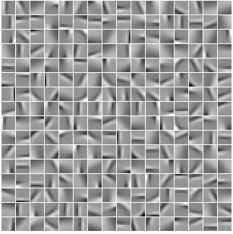
Sparse coding - Learning
Learned dictionary D by training in natural image patches

Slide 31
Sparse coding - Learning
Learned dictionary D by training in MNIST digits

Slide 32
Sparse coding
Cool, available software?
http://www.di.ens.fr/willow/SPAMS/
http://cs.nyu.edu/~koray
Applications
Image denoising
Inpainting
Classification
Recognition
...

Slide 33
Image processing applications

Slide 34
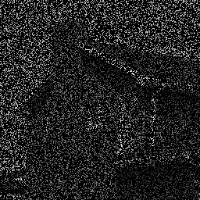
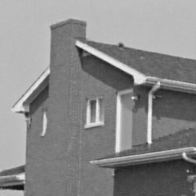
Sparse representations for image restoration [Mairal, Sapiro, and Elad, 2008d]

Slide 35
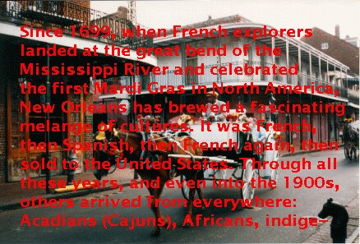
Sparse representations for image restoration Inpainting, [Mairal, Elad, and Sapiro, 2008b]

Slide 36
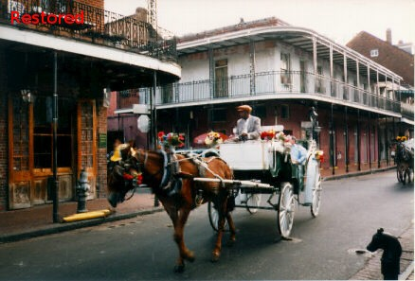
Sparse representations for image restoration Inpainting, [Mairal, Elad, and Sapiro, 2008b]

Slide 37
Sparse representations for video restoration
Key ideas for video processing
[Protter and Elad, 2009]
Using a 3D dictionary.
Processing of many frames at the same time.
Dictionary propagation.

Slide 38

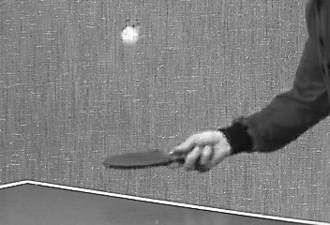
Sparse representations for image restoration Inpainting, [Mairal, Sapiro, and Elad, 2008d]
Figure: Inpainting results.

Slide 39

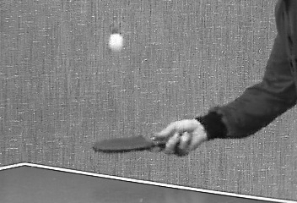
Sparse representations for image restoration Inpainting, [Mairal, Sapiro, and Elad, 2008d]
Figure: Inpainting results.

Slide 40

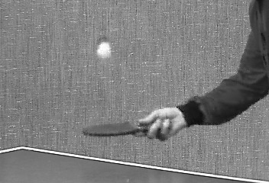
Sparse representations for image restoration Inpainting, [Mairal, Sapiro, and Elad, 2008d]
Figure: Inpainting results.

Slide 41
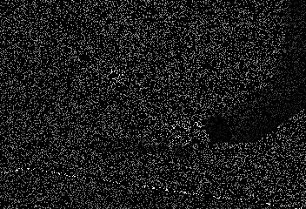
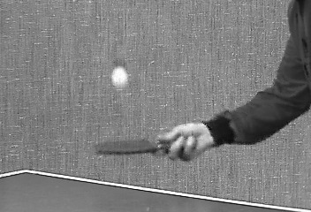
Sparse representations for image restoration Inpainting, [Mairal, Sapiro, and Elad, 2008d]
Figure: Inpainting results.

Slide 42

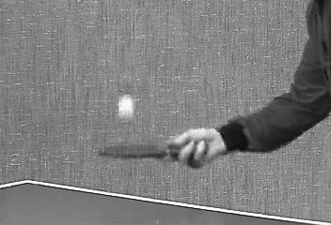
Sparse representations for image restoration Inpainting, [Mairal, Sapiro, and Elad, 2008d]
Figure: Inpainting results.

Slide 43
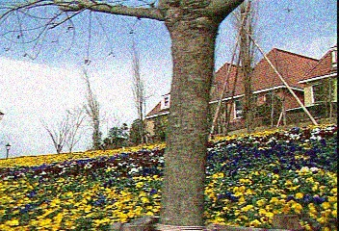
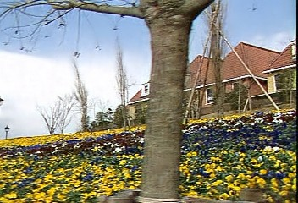
Sparse representations for image restoration Inpainting, [Mairal, Sapiro, and Elad, 2008d]
Figure: Denoising results. σ = 25

Slide 44
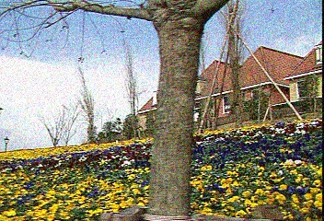
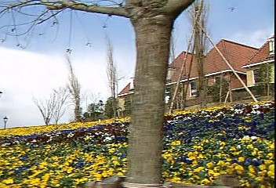
Sparse representations for image restoration Inpainting, [Mairal, Sapiro, and Elad, 2008d]
Figure: Denoising results. σ = 25

Slide 45
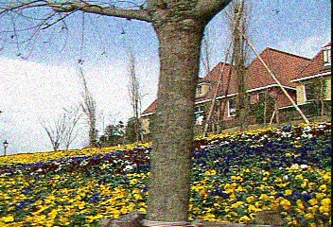

Sparse representations for image restoration Inpainting, [Mairal, Sapiro, and Elad, 2008d]
Figure: Denoising results. σ = 25

Slide 46
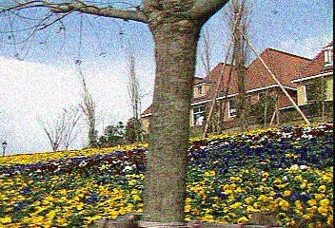
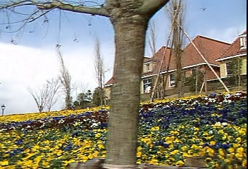
Sparse representations for image restoration Inpainting, [Mairal, Sapiro, and Elad, 2008d]
Figure: Denoising results. σ = 25

Slide 47
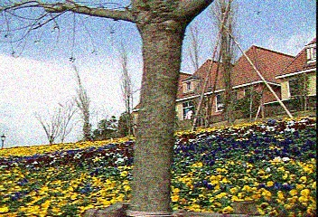
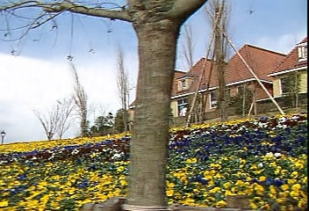
Sparse representations for image restoration Inpainting, [Mairal, Sapiro, and Elad, 2008d]
Figure: Denoising results. σ = 25

Slide 48
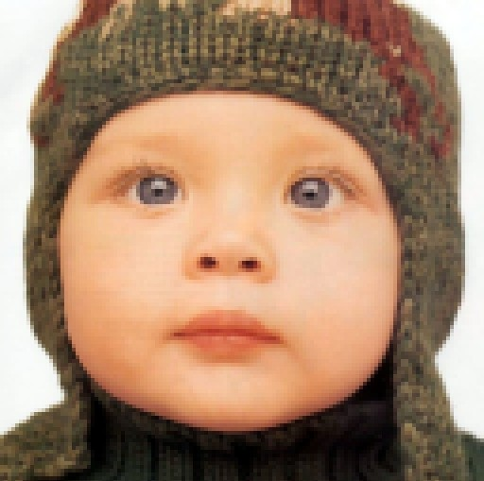
Digital zooming Couzinie-Devy, 2010, Original

Slide 49
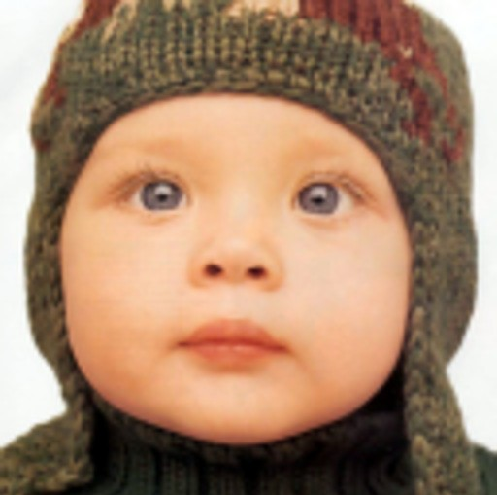
Digital zooming Couzinie-Devy, 2010, Bicubic

Slide 50

Digital zooming Couzinie-Devy, 2010, Proposed method

Slide 51
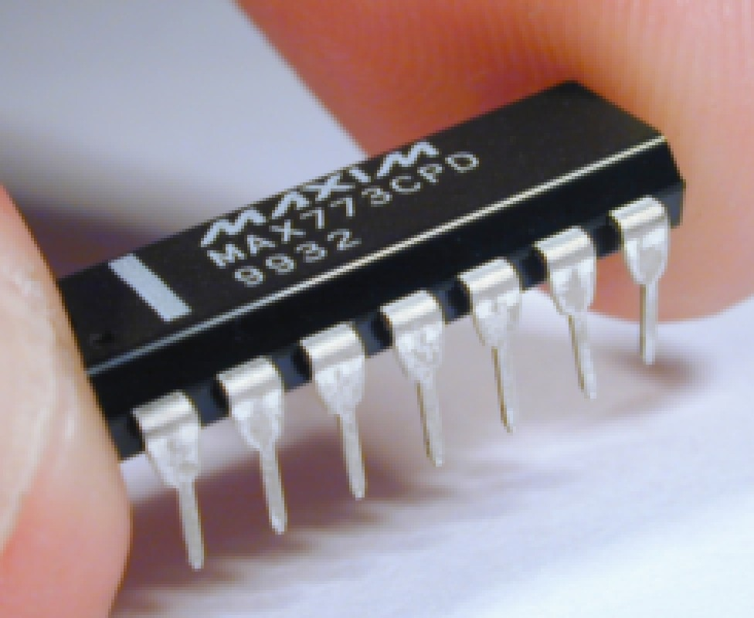
Digital zooming Couzinie-Devy, 2010, Original

Slide 52

Digital zooming Couzinie-Devy, 2010, Bicubic

Slide 53

Digital zooming Couzinie-Devy, 2010, Proposed method

Slide 54
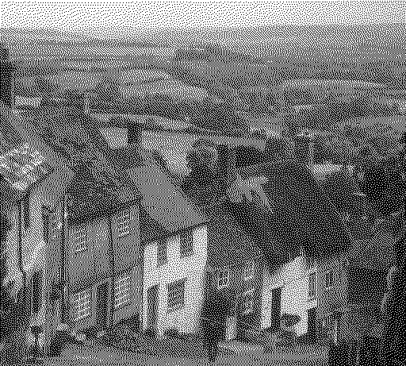
Inverse half-toning Original

Slide 55
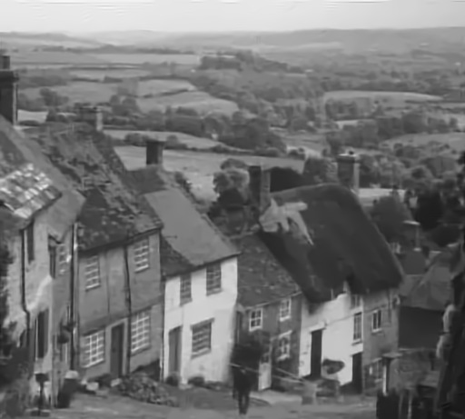
Inverse half-toning Reconstructed image

Slide 56
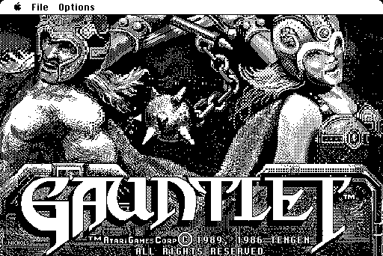
Inverse half-toning Original

Slide 57

Inverse half-toning Reconstructed image

Slide 58
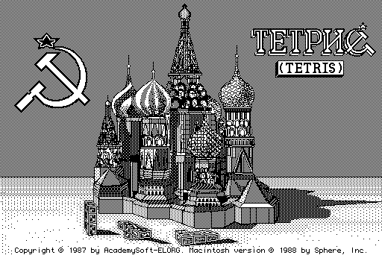
Inverse half-toning Original

Slide 59
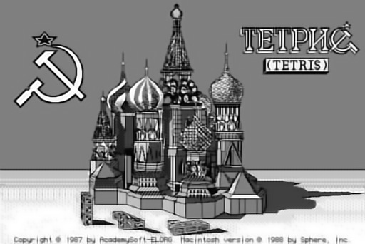
Inverse half-toning Reconstructed image

Slide 60
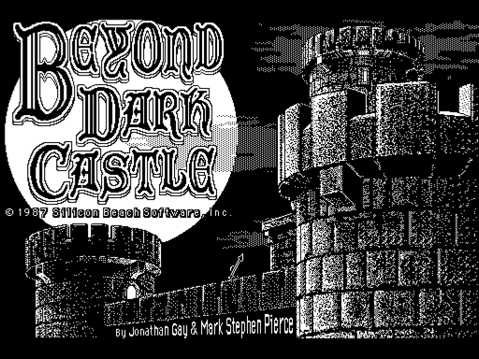
Inverse half-toning Original

Slide 61
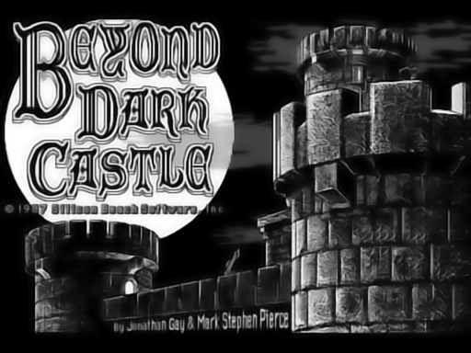
Inverse half-toning Reconstructed image

Slide 62
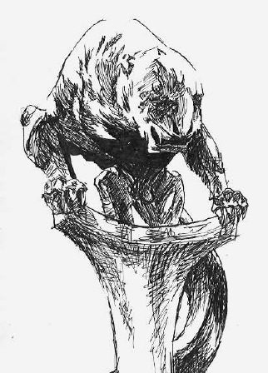
Inverse half-toning Original

Slide 63
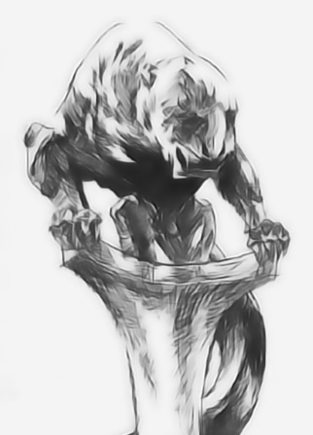
Inverse half-toning Reconstructed image

Slide 64
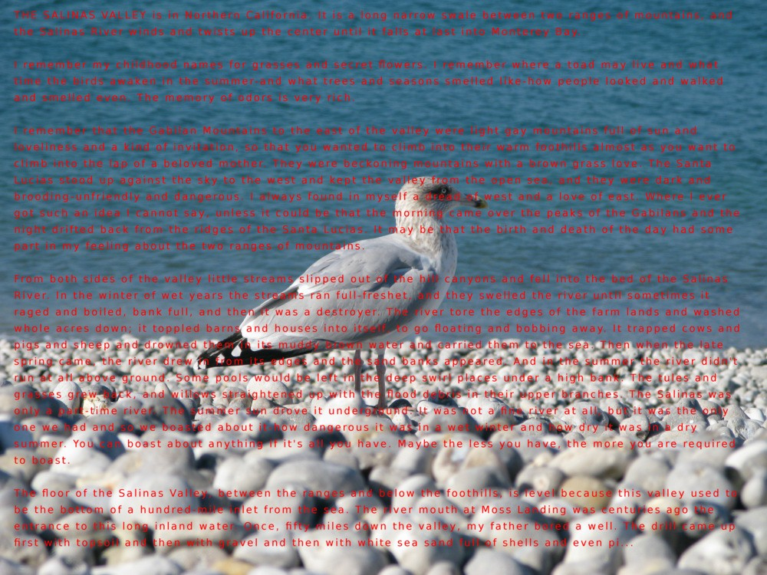
Optimization for dictionary learning Inpainting a 12-Mpixel photograph

Slide 65
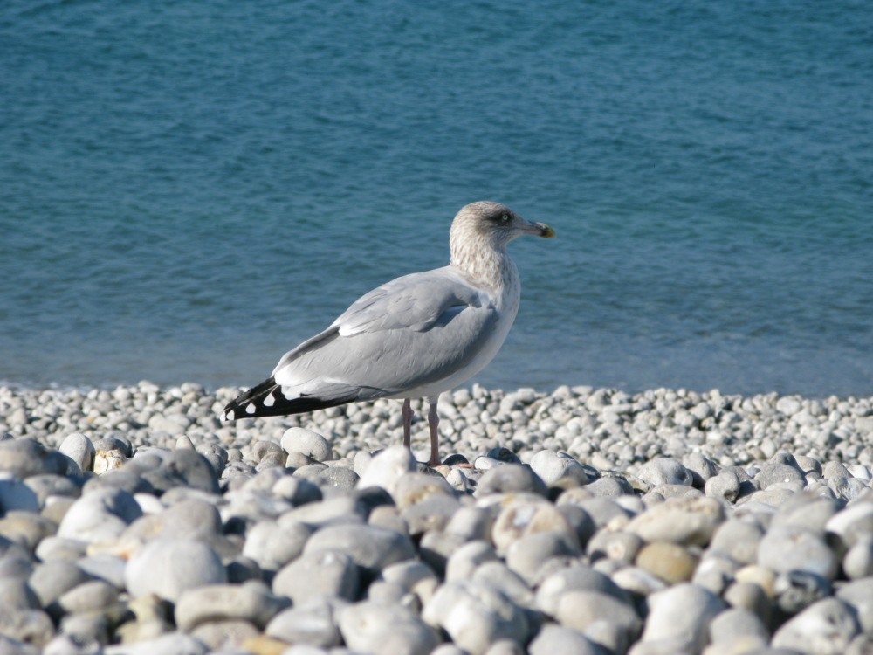
Optimization for dictionary learning Inpainting a 12-Mpixel photograph

Slide 66
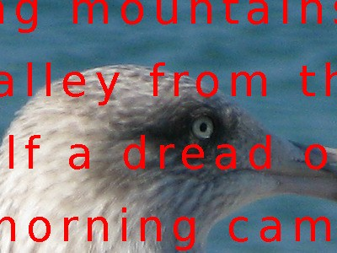
Optimization for dictionary learning Inpainting a 12-Mpixel photograph

Slide 67
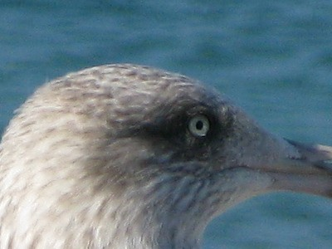
Optimization for dictionary learning Inpainting a 12-Mpixel photograph

Slide 68
Sparse coding for recognition
Recognition requires two basic operations
Feature extraction
Classification
Feature extraction
SIFT, HoG, ....
Convolutional Nets (w/o the last layer)
Use sparse coding inference as feature extractor
MP(Y) or ISTA(Y)

Slide 69

Sparse coding for recognition
Unsupervised Learning / Manifold Learning:
x_{i}

Slide 70

Sparse coding for recognition
Unsupervised Learning / Manifold Learning:
x_{i}

Slide 71
Sparse coding for recognition
Unsupervised Learning / Manifold Learning:

Slide 72
Sparse coding for recognition
Unsupervised Learning / Manifold Learning:

Slide 73
Sparse coding for recognition
Unsupervised Learning / Manifold Learning:

Slide 74
Sparse coding for recognition
Mid-level feature extraction
First layer
SIFT, HoG, .....
Second layer
Quantize into a visual wordbook
Do Sparse coding to learn wordbook

Slide 75
Learning codebooks for image classification
Let an image be represented by a set of low-level descriptors y_{i} at N locations identiﬁed with their indices i =1,..., N.
hard-quantization:
soft-quantization:
sparse coding:

Slide 76
Learning codebooks for image classification Table from Boureau et al. [2010]
Yang et al. [2009] have won the PASCAL VOC’09 challenge using this kind of techniques.

Slide 77
Training sparse inference
Sparse Coding solution requires per-datapoint optimization: L0 (very expensive) or L1 (expensive)
Efficient algorithms, but still slow
Can we train a feed-forward Neural Network that predicts sparse codes for feature extraction?
Predictive Sparse Decomposition (PSD) [Kavukcuoglu et al’08]
LISTA [Gregor,YLC’10]

Slide 78
Predictive sparse decomposition
Learning
For each sample from data, do:
Fix K and D, minimize to get optimal z
Using the optimal value of z update D and K
Scale elements of D to be unit norm.

Slide 79
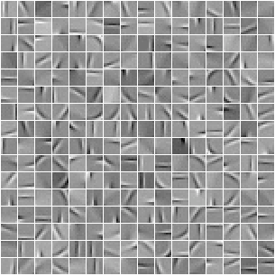
Predictive sparse decomposition
Encoder (K)
Decoder (D)
12 x12 natural image patches
256 dictionary elements

Slide 80
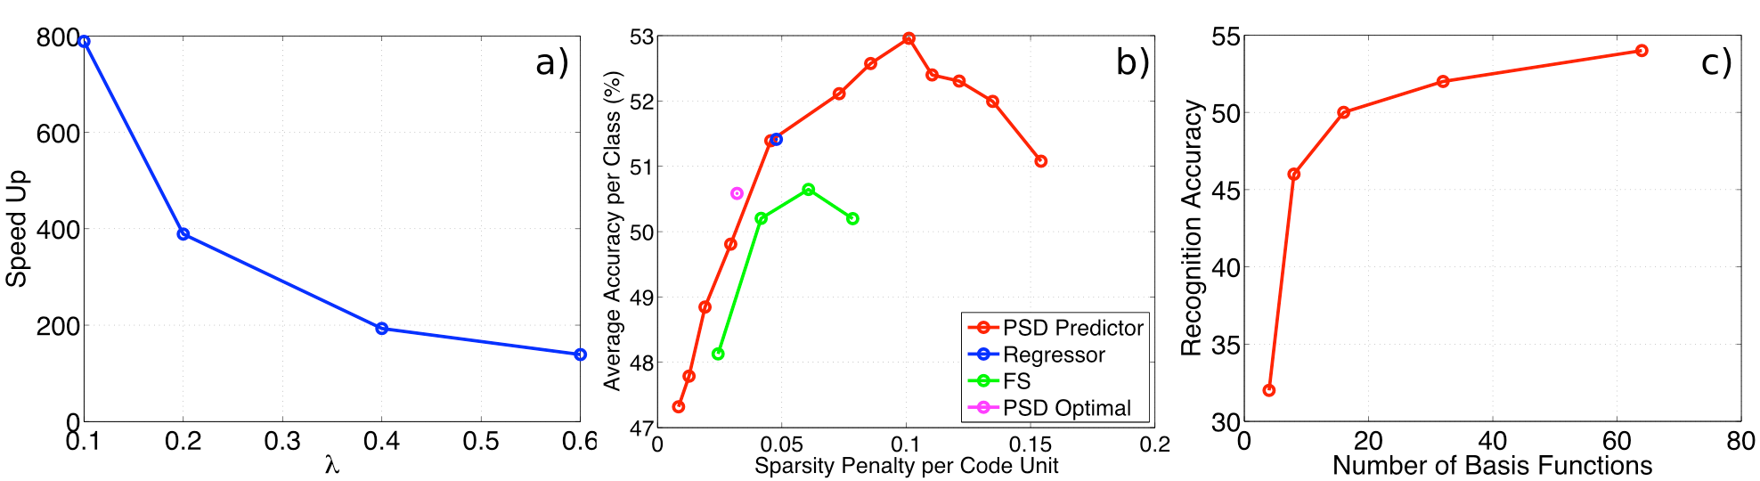
Recognition - C101
Optimal (Feature Sign, Lee’07) vs PSD features
PSD features perform slightly better
Naturally optimal point of sparsity
After 64 features not much gain
PSD features are hundreds of times faster

Slide 81
Pedestrian detection
Convolutional Predictive Sparse Decomposition
2 layer architecture
INRIA Dataset
Unsupervised Learning improves by 20%

Slide 82
Pedestrian detection

Slide 83
LISTA [Gregor & LeCun’10]
Proximal splitting algorithms (ISTA, FISTA):
Idea: Unroll the recurrence K steps:

Slide 84
Training LISTA
Results [from Gregor,YLC’10]:
Can perform “explaining away” unlike PSD with matrix S

Slide 85
Thank you

